Slide 1
Design Patterns
solutions to general problems in software development
explains a general design that addresses a recurring design problem

Slide 2
Design Patterns
Pattern | Description
Creational Patterns | These design patterns provide a way to create objects while hiding the creation logic, rather than instantiating objects directly using new operator. This gives program more flexibility in deciding which objects need to be created for a given use case.
Structural Patterns | These design patterns concern class and object composition. Concept of inheritance is used to compose interfaces and define ways to compose objects to obtain new functionalities.
Behavioral Patterns | These design patterns are specifically concerned with communication between objects.

Slide 3
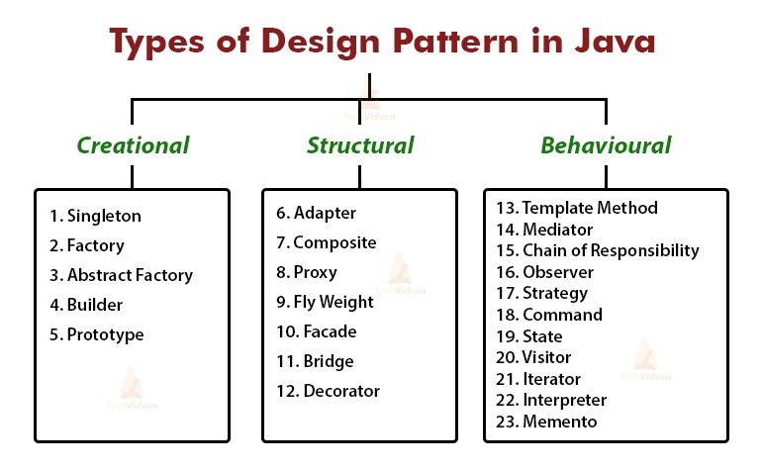

Slide 4
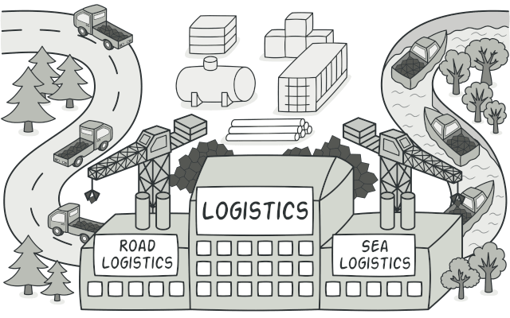
Factory Pattern
Factory pattern is a creational design pattern that provides an interface for creating objects in a superclass, but allows subclasses to alter the type of objects that will be created.

Slide 5
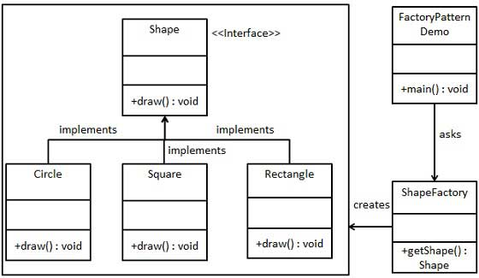
Design Patterns- Factory pattern

Slide 6
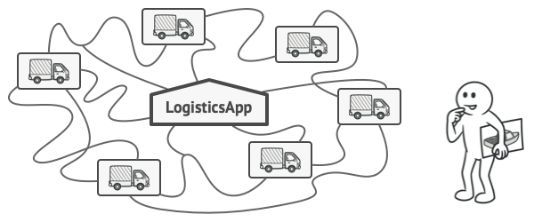
Factory Pattern- a use case
Imagine that you’re creating a logistics management application. The first version of your app can only handle transportation by trucks, so the bulk of your code lives inside the Truck class.
After a while, your app becomes pretty popular. Each day you receive dozens of requests from sea transportation companies to incorporate sea logistics into the app.
Adding a new class to the program isn’t that simple if the rest of the code is already coupled to existing classes.

Slide 7
References-factory pattern
https://www.tutorialspoint.com/design_pattern/factory_pattern.htm
https://www.geeksforgeeks.org/factory-method-design-pattern-in-java/
https://www.journaldev.com/1392/factory-design-pattern-in-java
https://refactoring.guru/design-patterns/factory-method
https://sourcemaking.com/design_patterns/factory_method/java/1

Slide 8
Singleton Pattern
Singleton design pattern allows us to create only one instance of a class and make sure that there exists only one Object in JVM

Slide 9

Singleton Pattern

Slide 10
Singleton Pattern -Reference
https://levelup.gitconnected.com/confused-with-java-singleton-design-pattern-have-a-look-at-this-article-4515adcab93e

